Slide 1
MPEGTS简介

Slide 2
相关的具体问题
分合流模块，播放dolby vision视频时，遇到卡顿，无画面等问题。
Ts 空数据包

Slide 3
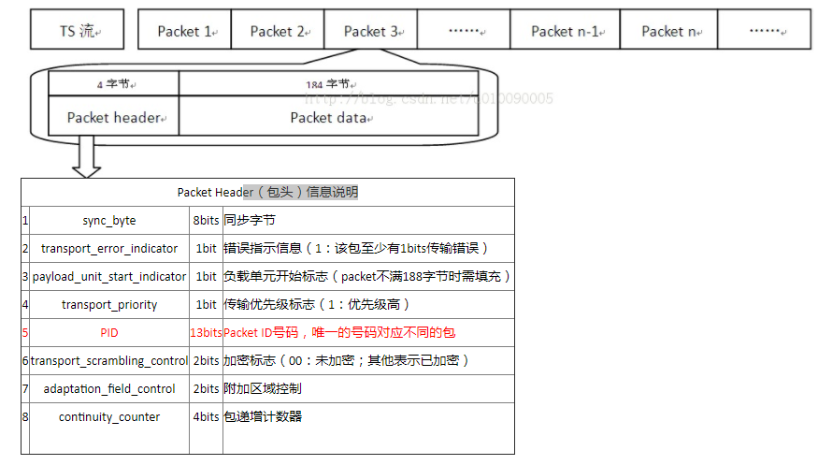
TS Packet Header
Ts数据包结构如下

Slide 4
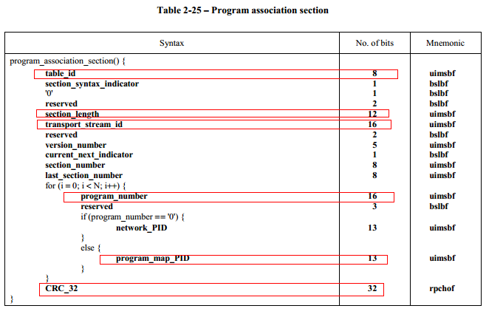
Program Association Table

Slide 5
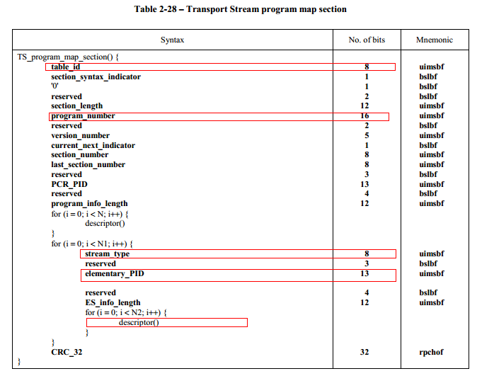
Program Map Table

Slide 6
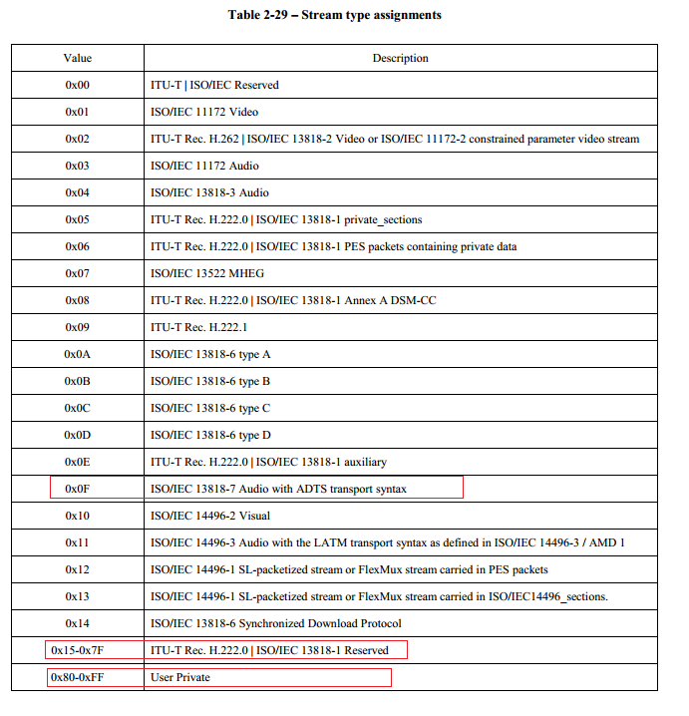
Stream Type

Slide 7
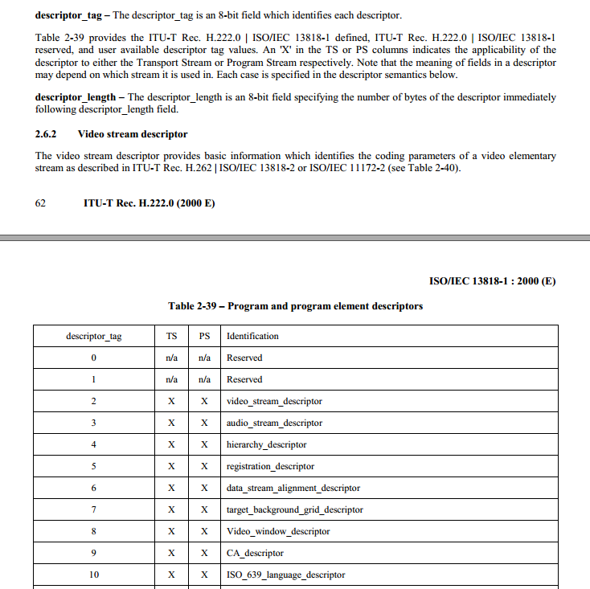
Descriptors

Slide 8
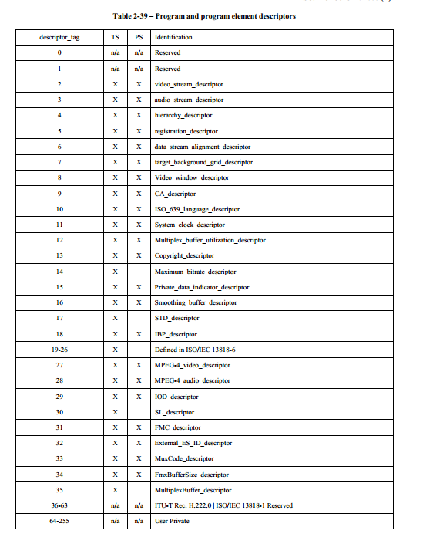
Descriptor Tags

Slide 9
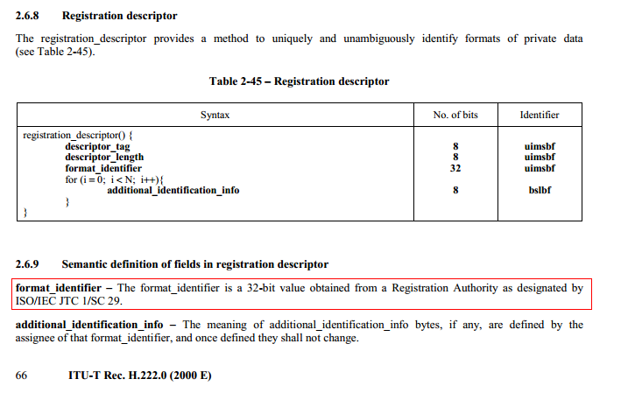
Registration Descriptor

Slide 10
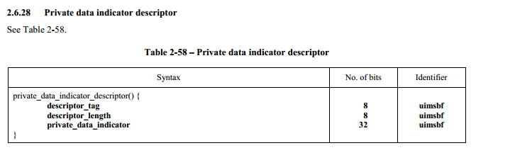
Private Data Descriptor

Slide 11
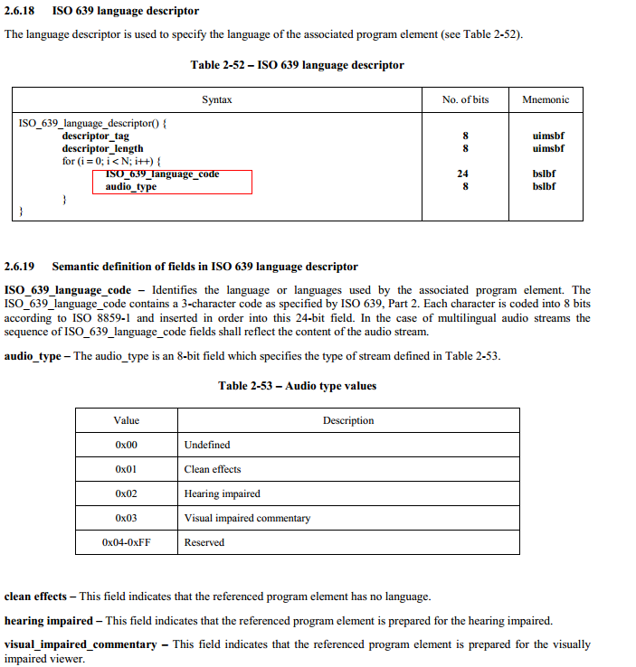
ISO 639 Language Descriptor

Slide 12
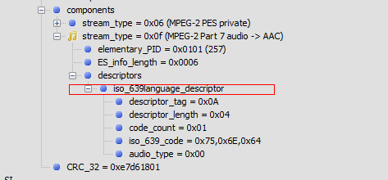
ISO 639 Information
https://en.wikipedia.org/wiki/List_of_ISO_639-2_codes

Slide 13
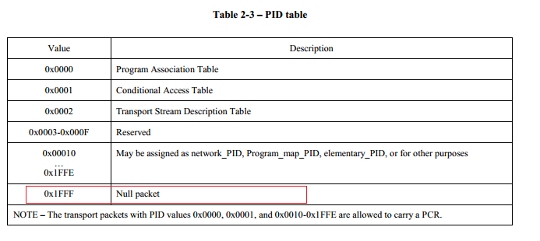
PID Table

Slide 14
NULL Packet
Transport Stream packets may be null packets. Null packets are intended for padding of Transport Streams. They may be inserted or deleted by re-multiplexing processes and, therefore, the delivery of the payload of null packets to the decoder cannot be assumed.
For null packets the payload_unit_start_indicator shall be set to '0'.
PID value 0x1FFF is reserved for null packets (see Table 2-3).
In the case of a null packet the value of the transport_scrambling_control field shall be set to '00' (see Table 2-4)
In the case of a null packet the value of the adaptation_field_control shall be set to '01'.
In the case ofa null packet the value of the continuity_counter is undefined.
In the case of null packets with PID value 0x1FFF, data_bytes may be assigned any value. The number of data_bytes, N, is specified by 184 minus the number of bytes in the adaptation_field(), as described in 2.4.3.4 below

Slide 15
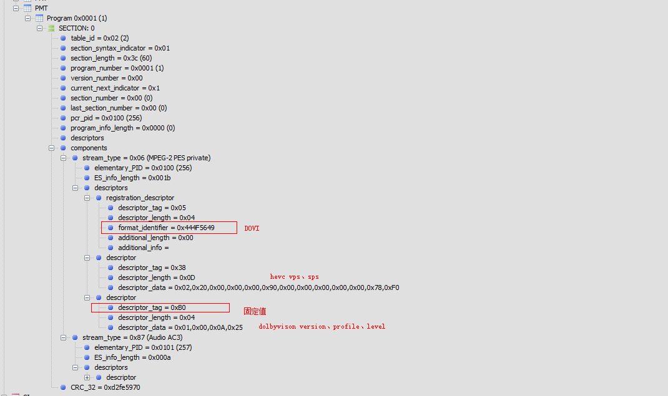
Pmt Example
0x444F5649 ->DOVI

Slide 16
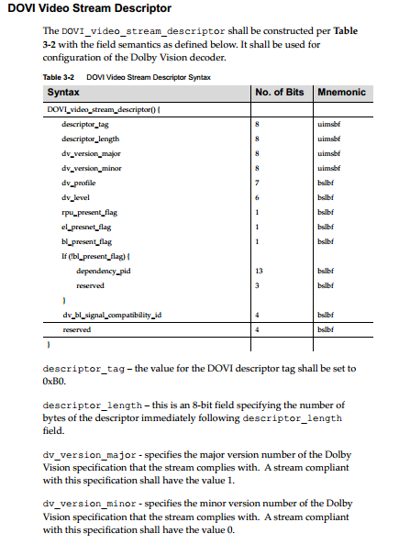
DolbyVisoion Descriptor

Slide 17
Net Abstract Layer Unit (NALU)Type
 | VPS | SPS | PPS | IDR
Hevc | 0x40 | 0x42 | 0x44 | 0x26
H264 |  | 0x67 | 0x68 | 0x65

Slide 18
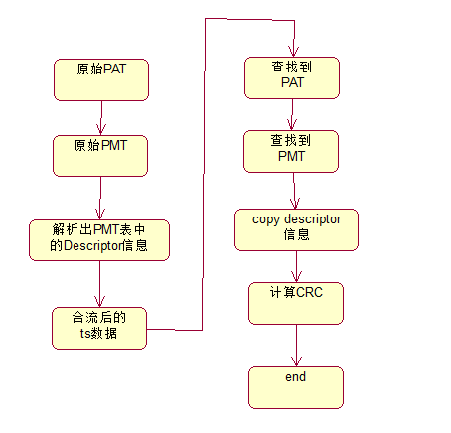
Activity Diagram

